Slide 1


Slide 2
Designing a shaft system

Slide 3
Inter-relation of Shaft Sub-system with other sub-systems
A Shaft system is a sub-system of the mine as a whole .
It is functionally inter–related to many other sub-systems, of which some of the important ones could be identified as follows:
Mine transport
Mine ventilation
Dewatering
Production
Surface arrangements, etc.

Slide 4
INTER RELATION OF A VERTICAL TRANSPORT SUB-SYSTEMS OF AN U/G MINE
MINE PRODUCTION SYSTEM
MINE TRANSPORT SYSTEM
SURFACE-SUB SYTEMS
SHAFT
SUB-SYSTEM
MISC.
SUB-SYSTEMS
MINE VENTIALTION SUB-SYSTEM
MINE DEWATERING
SUB-SYSTEM

Slide 6
Elements of a shaft system
The elements constituting a shaft system are enumerated are as follows
Head frame
Winder house & foundation
Shaft collar & headframe foundation
Fan drift , inset and openings and lining in the shaft
Guide fittings, platforms, decking arrangements, etc
Pipe fittings
Skips and cages

Slide 7
Multi-disciplinary Approach
The elaboration of designs of a shaft system is a multi- disciplinary effort .
The disciplines involved are mining, civil/structural ,mechanical and electrical/ electronics.
The engineers from different disciplines are to work in close collaboration in a team because the different elements of the system are highly inter-related and inter-dependent

Slide 8
DISCIPLINE WISE DISTRIBUTION OF THE DESIGN WORK
SHAFT SYSTEM
LINING & SUUPORT
INSET DESIGN
CO-ORDINATION
WINDER SPECIFICATIONS
MINING
SIGNALLING &
CONTROLLS
POWER SUPPLY
ELECTRICAL
VERTICAL
TRANSPORT SYSTEM
OUT FITTINGS
PIPEFITTINGS
SKIP LOADING&UNLOADING
LANDING& PLATFORMS
CAGES& SKIPS
MECHNICAL
HEAD FRAME
SHAFT COLLAR&
BACKSTAY
FANDRIFT
WINDER FOUNDATION
&HOUSE
CIVIL

Slide 9
Workload and Inputs Required
Three basic inputs for the design work are
Expertise: The expertise means the know-how which consists of a clear understanding of functional requirements, the design criteria to be applied and knowledge of prevalent design codes and norms.
Establishment : The establishment would include a well- equipped design office , sufficient number of design engineers and drawing office staff.
Expenses: While the man days required to be spent on the design of a shaft system would depend on the magnitude and complexity of individual task

Slide 10
Workload and Inputs Required
The distribution of time under the different design aspects is given below:-
Functional design ------ 20%
Design criteria ------- 5%
Engineering calculations ----- 25 %
Preparation of drawings ----- 50%

Slide 11
Basic technical data required
Before taking – up the design work of a shaft system, considerable basic data is required to be collected.
This basic data could be grouped under four categories . They are
Functional
Geo-technical
Geographical
Operational.

Slide 12
Functional
ventilation requirements (required 15m/s ,for man winding 8m/s)
peak hourly winding capacity and nature of winding duty
levels of winding (conveyor gradient should not be greater than 1 in 4)
layout of other surface features
details of incoming and outgoing transport system
underground drainage layout (pipes entering & leaving the shafts)
special conditions, if any.

Slide 13
Geo-technical
Strata log
Soil characteristics (for foundation)
Rock properties (founding level of shaft, lining support of insets)
Hydrology (from sinking point of view, water pressure for lining, position for water )
Chemical analysis of water (concrete composition)

Slide 14
Geographical
Surface topography
Location in respect to wind direction ,seismic waves, etc.(wind level or throw of dust)
Highest flood level(collar level), if relevant.
Operational
Statutory requirements
Prevalent codes and practices

Slide 15
Design of Shaft System
The shaft system design specifies the following :
The specifications of the winding system and location of winder
Shaft cross-section showing the position of conveyances, guides, pipelines, etc
General configuration of headframe giving overall levels and dimensions
Various insets and openings in the shaft.

Slide 16
Choice of winding system
Major items on which decision is to be made are as follows :
Balanced winding or counter-weight system;
Winding cycle and payload;
Type of conveyance and dimensions;
Nature of guides and locations;
Type of winder

Slide 17
Balanced winding or counter weight-system
However, if winding from several levels is to be done frequently, a counter-weight system is chosen.
In some special situations when more than one winding plant has to be provided in one shaft or a large size cage is to be accommodated, counter-weight system is chosen from space considerations in the shaft.

Slide 18
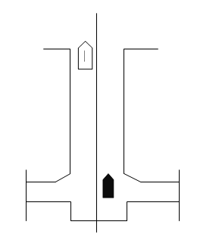
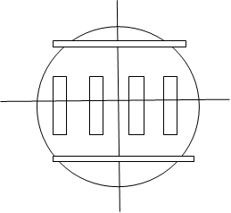
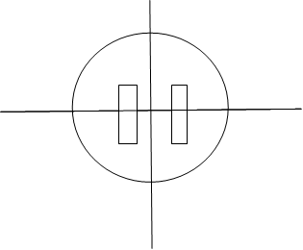
Balanced winding
SINGLE LEVEL WINDING
ROPE GUIDES
DIA UP TO 5.2M
ONE PAIR OF CONVEYANCE
RIGID GUIDES
DIA 7.2 TO 7.5M OR MORE
TWO PAIR OF CONVEYANCE

Slide 19
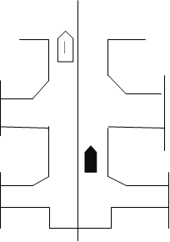
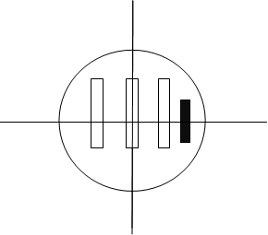
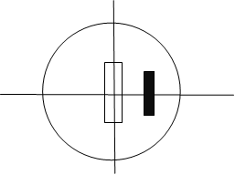
Single level winding
MULTI LEVEL WINDING
RIGID GIDES DIA 6.5M
ONE PAIR OF SKIP
SINGLE CASE WITH COUNTER WEIGHT
ROPE GUIDES
DIA<4.8M
SINGLE CASE WITH CUNTER WEIGHT

Slide 20
Winding cycle and pay load
The greater the payload and smaller the speed , safer and more efficient is the wind.
The peak power requirement also goes down with the speed.
The size of the conveyance, rope and winding machine will become larger and more expensive with the increase in payload.
Theoretical winding cycle indicating the period of acceleration and deceleration and the constant winding speed can be worked out after providing for the decking time.

Slide 21
Winding cycle and pay load
However, the theoretical winding cycle is required to modified from practical operational considerations by providing additional time
This is to ensure smooth starting and stopping operations as well as change over from the acceleration and deceleration periods to the period of constant speed.
Once the winding cycle is decided, with the help of the peak hourly winding capacity, the payload can be worked out.

Slide 22
Type of winder
Friction winders
In case of friction winders the ratio of the rope tensions on the loaded and empty sides are to be maintained all the time
For depths less than 300 metres, use of friction winder is not advantageous from the fact that
The ratio of rope tensions in the static state is limited to 50% of the suspended weight on the rope
The pay load thus gets very limited in this case
For greater depths and within prevalent depth ranges of the present day coal mining industry friction winders would be more advantageous
.

Slide 23
Type of winder
Friction winders
In case of a friction winder the conveyance cannot be decked on keeps or platforms and the conveyance all the time remains suspended on the rope.
Due to rope stretch the position of the conveyance varies according to the load in conveyance and, therefore, for friction winders operating cages elaborate decking arrangements involving use of swinging platforms, pusher rams etc. are to be made.
Balance rope being an essential item of friction winder the conveyance is to be designed to sustain the load of balance rope.

Slide 24
Type of winder
Friction winders
In case of friction winder according to requirement of payload and depth a single rope or multi-rope friction winder can be chosen.
Multi -rope winder
A multi-rope winder results in the reduction in the size of mechanical parts of winder and thereby in the cost of the winder

Slide 25
Location of winder
limitations of fleet angle and the rope angle are deciding factors for location of winder
In case of friction winder the alternative of locating the winder on the top of the headframe should also be examined.
Location on the head frame can be sufficiently competitive, If the diameter of the drum of a multi-rope friction winder is such that it can be installed on the headframe without use of deflection pulleys then in that

Slide 26
Location of winder
If sufficient space is available the ground location is preferred and is economical.
In case of ground mounting of friction winders it is preferred to keep the fleet angle very low.
With this objective, the two winding pulleys are located at different levels and the winding machine is located at right angles to the longer axis of the conveyance, thereby eliminating the fleet angle completely.

Slide 27
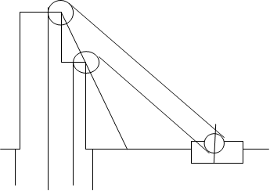
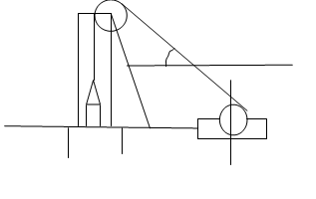
Criteria for location of winder
Friction winder with pullies in the same plane

Slide 28
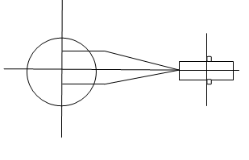
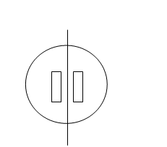
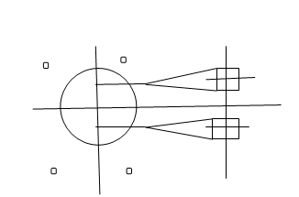
Criteria for location of winder
Friction winder with pullies in the same level

Slide 29
Type of conveyance and dimensions
Simultaneous decking of more than one deck of the cage for changing of tubs/mine cars requires elaborate car handling arrangements involving considerable expenditure.
T he ratio of payload to dead load in cage winding system is also rather unfavourable.
whenever the production envisaged from a single pit is 0.6 m. tonnes or more per annum, the choice leans heavily in favour of skip winding.

Slide 30
Type of conveyance and dimensions
For men and material winding single or multi-deck cages are chosen according to duty requirement
For men winding the attempt should be to lower the men in the major shift in 30 minutes.
The most common base dimension of cages and skips are equivalent to those of a commonly used tandem tub cage.

Slide 31
Type of conveyance and dimensions
While for man winding simultaneous decking of more than one deck is considered, the material cars are normally handed only from one level to which different deck of the cages are levelled in succession.
For the base dimensions of cage the prevailing dimensions of tubs/mine cars are considered. The base dimensions of cages and skips are generally kept the same.

Slide 32
Nature of guides
If it is possible to provide adequate clearances between the conveyances and the conveyance and the sides of shaft rope guides are preferred due to low cost and ease of installation.
Otherwise rigid guides are chosen.
In case of multi-level winding where a counter weight system is adopted rigid guides are used for the conveyance and rope guides are provided for the counter-weight.

Slide 33
General configuration of head frame
The main purpose of the headframe is to support winding sheaves provided for directing the winding ropes connected to the conveyances in the shaft towards the winding engine.
In case of tower mounted winder the winder is in the line of movement of conveyance and no winding sheaves are necessary. In such a case the purpose of headframe is to support the winder itself.
The height of the winding sheaves depend on the height to which the conveyance is to be normally raised and the extra over run distance to be provided for safety.

Slide 34
General configuration of head frame
The headframe to also provide support for the guiding arrangements of the conveyance for its movement above ground and the safety devices like over winding protection, fences and gates.
The head frame structure has to provide adequate openings for the movement of men and material to and from the conveyances.

Slide 35
General configuration of head frame
head frames are broadly categorised into two distinct groups :
i) Conventional British type of head frame :
The British type of head frame is more rigid and less amenable to adjustments on account of strata movements in the vicinity of the shaft.
At the same time it is more economical from the point of view of erection as well as construction costs
ii) Head frames popularly adopted on the European Continent.
The head frame commonly used on the European Continent is more flexible and can be easily adjusted in case of any strata movement in the vicinity of the shaft.
On the other hand it is more difficult to erect and is more costly.

Slide 36
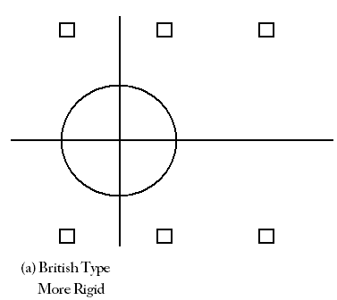
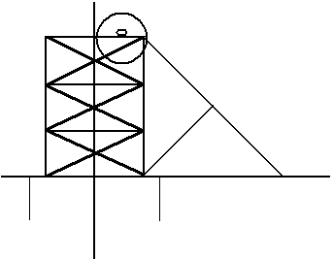
Types of HeadFrames
British type

Slide 37
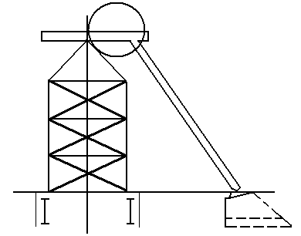
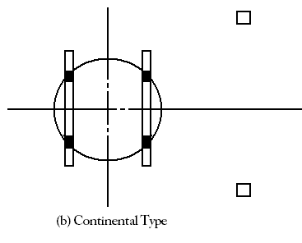
Types of Headframes
Continental Type

Slide 38
Various insets and openings in the shaft
The size of the opening is decided on the basis of following :
Clearances required between tubs/mine cars and between tubs/mine cars and the sides also for passage of men in man winding shafts
In case of simultaneous decking of more than one deck of the cage the height is to be decided in relation to the position of such decks
Dimensions required for passage of ventilation air and suitable shape for smooth change in the direction of air current
Dimensions necessary for handling long materials.

Slide 39
Various insets and openings in the shaft
The position for the skip loading arrangement is located in relation to the overall transport arrangements in the mine and in relation to the following aspects.
Location of the bunker from which the measuring pockets/loading conveyors are to be fed.
Size of the measuring pockets.
C or S arrangement for loading and un loading.

Slide 40
Various insets and openings in the shaft
The location and size of ventilation opening is to be decided on following considerations:
Quantity of ventilation air.
Position of conveyances in the shaft the lowest possible position of conveyance while decking.
Position of foundation of shaft collar.

Slide 41
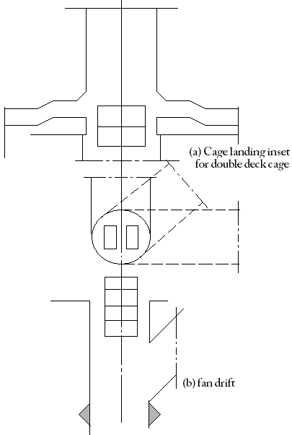
Criteria for design of Insets

Slide 42
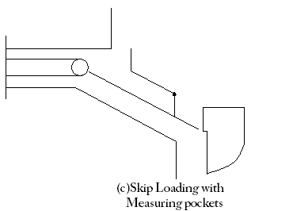
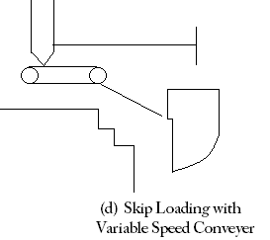
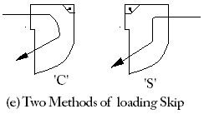
Criteria for design of Insets

Slide 43
Winder foundation
Basic data required
1) Frame dimension of winder and component layout;
2) Static load detail of important components
3) Dynamic load details;
4) Soil / rock characteristics
Design procedure
1) On the basis of dimensions of the winder and oil/rock characteristics, length ,breadth of foundation is decided;
2) Centre of gravity of foundation block with machine components is ascertained

Slide 44
Design procedure
3) Geometrical inertia and location of neutral axis is worked out;
4) Maximum pressure on rock/soil based on static load and overturning moments is worked out and compared with permissible pressure.
5) Steps 2 and 4 are repeated for different combinations of dynamic load and in each case the founding pressure should be less than the permissible limit.
6) Foundation is checked for horizontal sliding.
7) Anchorage strength of individual components is checked.

Slide 45
Head frame
The head frame structure is designed to withstand event of rope rupture.
Two extreme case are considered viz.,
Conveyance getting stuck-up in the shaft.
Conveyance getting stuck-up in the head frame.
The stresses distribution in all members is worked out and compared with permissible stress limits.

Slide 46
Head frame
In case of drum winders the beams supporting the bell plate of safety detaching hook are designed to withstand 3 times the weight of the loaded cage or skip.
In case of friction winder the buffer beams are designed to withstand the forces in the event of rope rupture.
The beams supporting the catches for holding the conveyance are designed to sustain five times the weight of a loaded conveyance

Slide 47
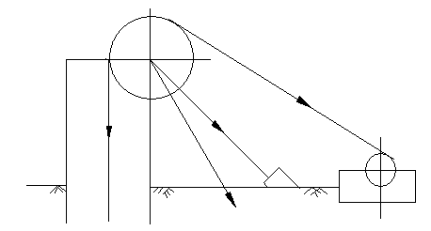
Criteria for designing a Headframe
Stresses when conveyance is stuck up in the skip

Slide 48
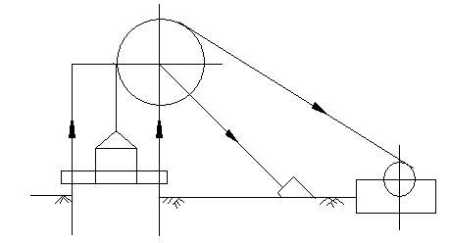
Criteria for designing a Headframe
Stresses when the conveyance is stuck up in the head frame

Slide 49
Conveyance
For cages the hangers are designed for a factor of safety of 10.
The hangers are also to be checked in this case against buckling.
The arrangement of unloading gates and emergency man riding are also to be selected and designed

Slide 50
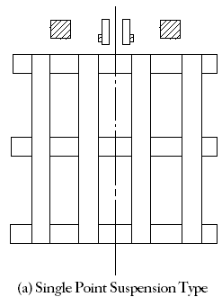
Designing a Cage

Slide 51
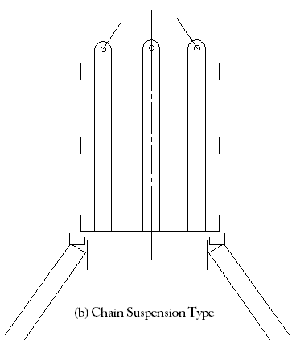
Designing a Cage

Slide 52
Shaft Collar
Purpose of the shaft collar
To provide support against loose strata near the surfaces;
Where front legs of the head frame rest on the collar to act as their foundation.
Design procedure
The collar is to be founded on good rock.
Foundation is to withstand self-weight of the collar and in appropriate cases weight of the head frame as well as the dynamic loads in the event of rope rupture.
For deep founding level the collar is also to be considering as a column and analysed accordingly .
While designing collar appropriate openings are to be left for ventilation drift, and for taking out pipe ranges and cables as well as for installation of decking equipment

Slide 53
Other elements
There are various types of shaft linings viz., brick work, monolithic concrete lining, reinforce concrete, prefabricated segments of steel or concrete, gunniting etc.
If strata layer is anticipated a special layer of material like bitumen is to be inserted between the strata and lining to permit free movement.
Special type of lining is also required to be provided if water seepage is to be completely prevented.

Slide 54
Other elements
Sizes of pipelines are to be chosen according to the quantity of water required to be handled and the thickness of the pipe range depends upon the static and dynamic head.
Once these parameters are decided, the supports can be designed on the basis of the load of the range.
In some of the cases expansion joints are also considered if appreciable seasonal temperature variations are anticipated in the shaft.
Rigid guides have to withstand the horizontal and vertical forces due to the movement of the conveyance and these guides and their supports are to be designed taking these aspects into consideration.
Extra provision is also required to be made against weakening due to corrosion.

Slide 55
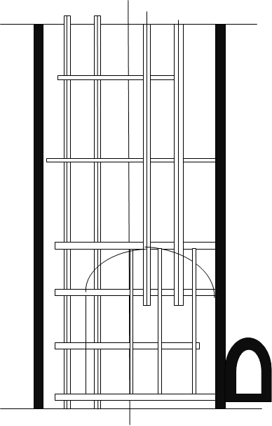
Shaft outfittings

Slide 56
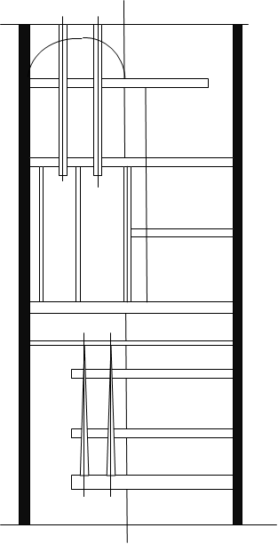
Shaft outfittings

Slide 57
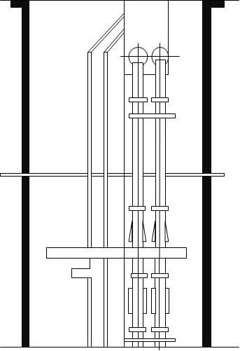
Pipe supports in the shafts

Slide 58
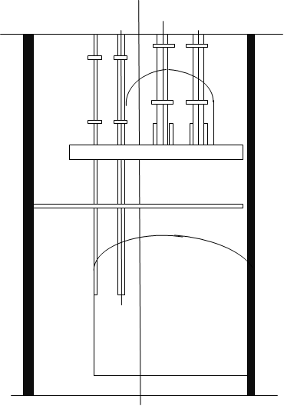
Pipe supports in the shafts

Slide 59
Conclusion
The overall life requirement also influences the design
For an economic design the general inclination towards over-design has to be avoided without sacrificing the safety aspect.
However, there are areas of design where as yet a clear understanding about the forces coming into play is lacking and there is a conflict about the appropriate design criteria to be adopted.

Slide 60
Conclusion
In such situation, it may be necessary to adopt an over design so as to be absolute sure about the safety aspect
As the elemental design is to be integrated in the overall system and the different elements are being designed by different design engineers a constant coordination is required to see that the various element so designed are properly fitting in, in the overall system.
In this process there are many occasions where various elemental designs are revised.

Slide 61
MECHANISED SINKING
Preparatory work
The chosen shaft site to be connected by an all weather road to the main road.
A network of roads to be constructed within the main area for efficient transport.
Adequate power supply and water supply to be made available (1 to 1.5 MVA substation).
A general plan of the surface to be prepared showing both permanent and temporary service and residential buildings and structures( roads, dump yard, etc) .
structures to be so located that they do not interfere with permanent structures to be built later.

Slide 62
MECHANISED SINKING
Preparatory work
Fixing the centre of the shaft and its axes , bench marks etc.
With the help of permanent survey points at locations where these will not be disturbed.
Contour plan of the area at 1m interval for about 500m from the shaft.
The site to be levelled whenever needed and temporary and permanent structures to be erected

Slide 63
Dealing with water in a sinking shaft
Rate of water flow Method of removal of water
*Upto 2 cu.m/hr ----- in kibbles filled with the help of
buckets. Removed with the debris.
*Upto 5 cu.m/hr ----- Shallow shaft—in kibbles which are
filled by light pumps (1.5cu.m/trip)
Deep shaft – Suspended sinking pumps.

Slide 64
Dealing with water in a sinking shaft
Rate of water flow Method of removal of water
*5 – 50 cu.m/hr ----- Shallow shaft (<250 m ) Suspended sinking pumps. Deep shaft (>250 m )— shaft pumping.
*>50 cu.m/hr ------ Probably it will be more economical to seal off the water by cementation – if ground condition permit cementation.
** Balance the cost and time in cementation against the cost of pumping.

